Slide 1

WHAT IS GENETIC ALGORTIHM ?

Slide 2



Process
Definition
Initial Population
Fitness Function
Reproduction
Termination
Heuristic Search Method
-Optimization Problem
Genetic Operators
-Selection
-Crossover
-Mutation
WHAT IS GENETIC ALGORITHM ?

Slide 3

HOW ARE WE GOING TO IMPLEMENT GA?

Slide 4
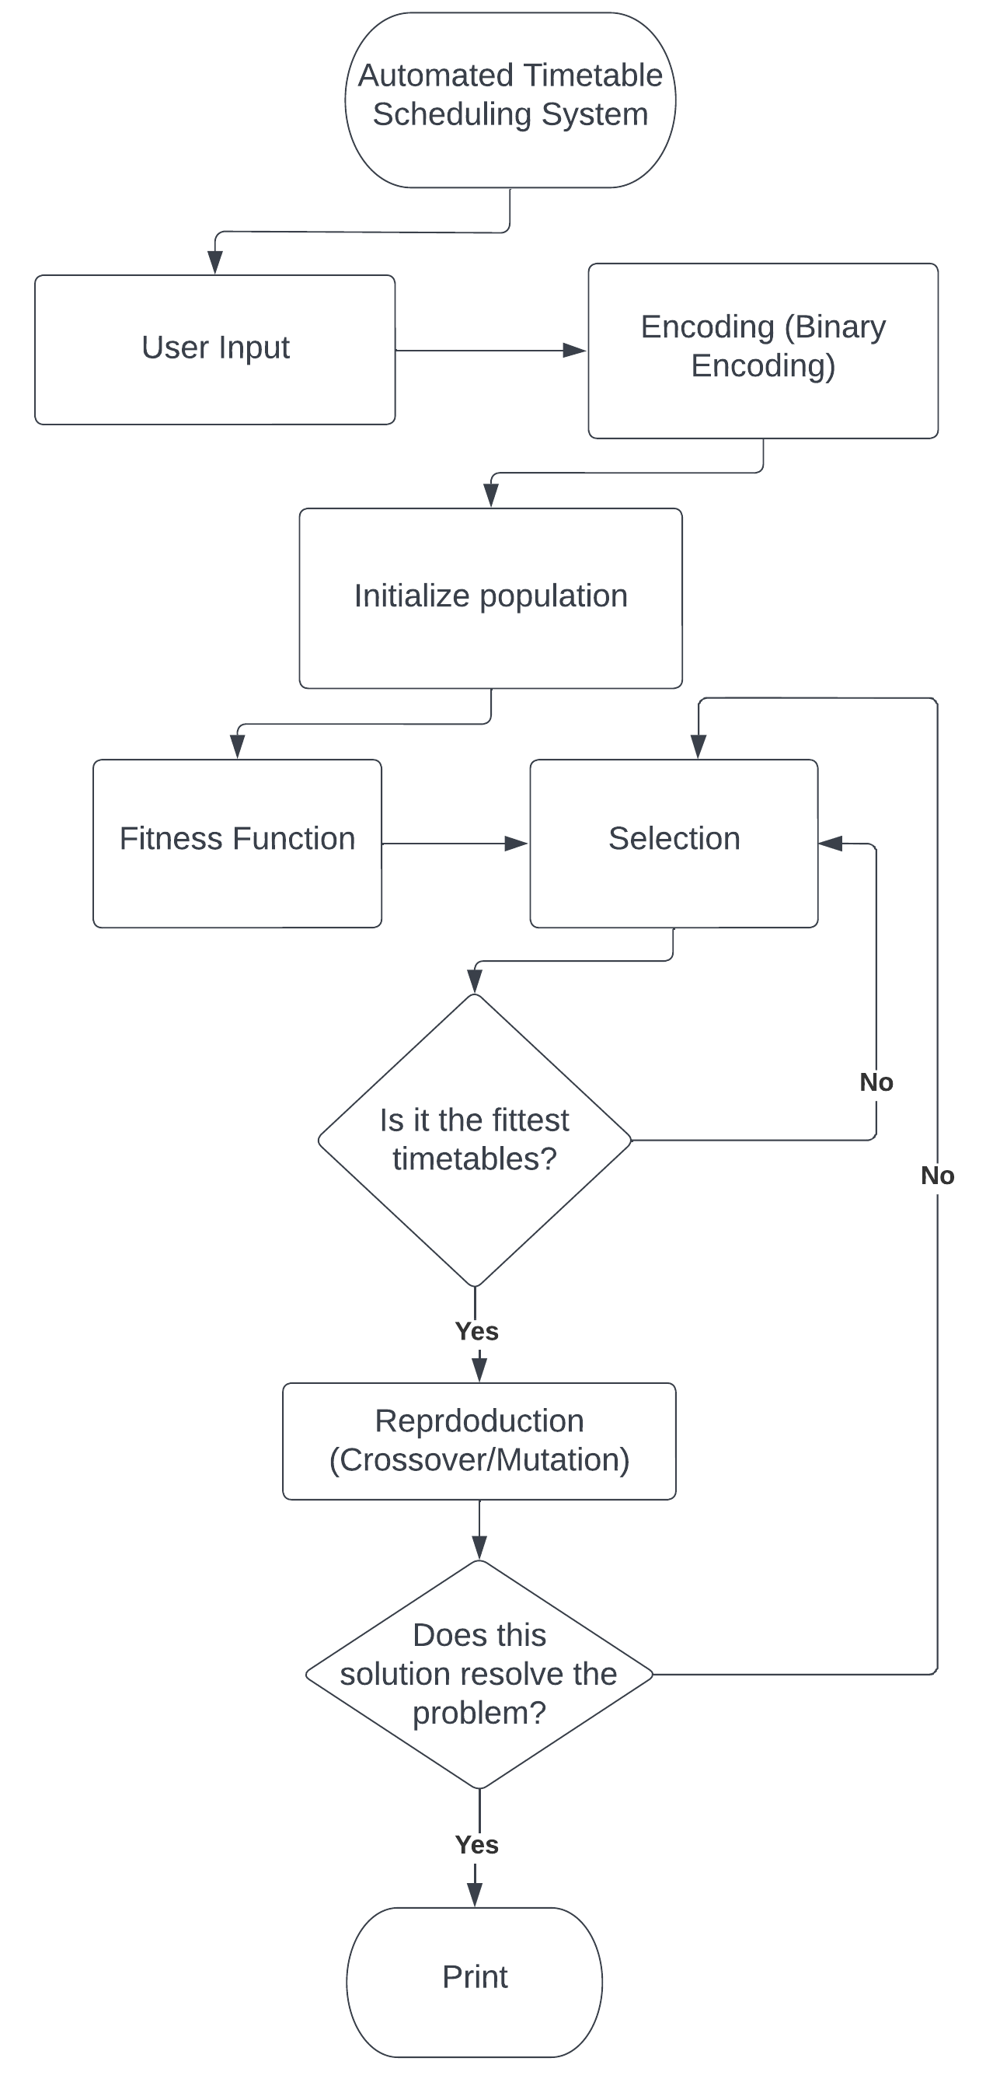
HOW ARE WE GOING TO IMPLEMENT GA?

Slide 5

THANK YOU!

